Slide 1

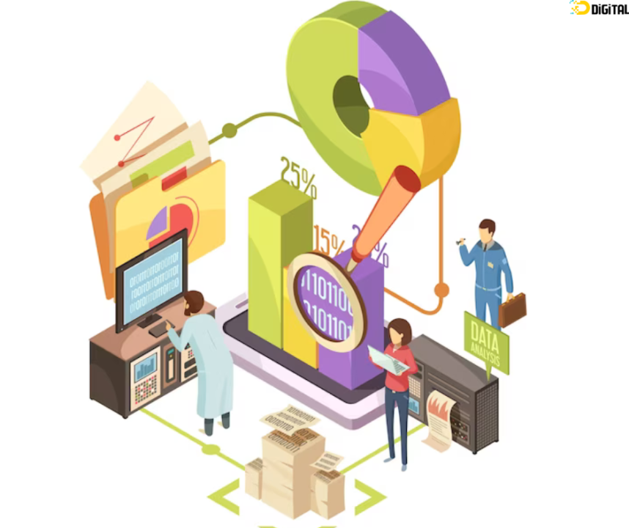
Final Project Report
Enhancing Customer Engagement and Predictive Insights in Retail
Group 3
Krishna Karthik Reddy Chavva
Swapnil Roy
Rohit Bharadwaj Balarama Somayajula
Vignesh Sridhar
Northwestern University
422 - Practical Machine Learning
18-August-2023

Slide 2




Team Intro
Karthik
Swapnil
Vignesh
Rohit
Notes:
Discover actionable insights from a comprehensive analysis of the Online Retail II dataset, spanning two years of genuine UK online retail transactions. This analysis empowers strategic decision-making, enhances customer engagement, and refines predictive marketing strategies for non-store, all-occasion giftware retail. Through in-depth exploration of transaction dynamics, customer behaviors, and predictive modeling, this initiative aims to revolutionize business operations and amplify overall performance. Join us as we unlock the potential of data-driven excellence.

Slide 3

Introduction
Imagine you could peek into the minds of your customers and discover what they want, when they want it, and how much they are willing to pay for it. Imagine you could turn this data into smart decisions that boost your sales, loyalty, and satisfaction.Sounds too good to be true, right?
We tried the same !
We picked Online Retail II dataset with two years of real-world transactions from a UK-based online giftware retailer. This dataset covers the period from December 1, 2009, to December 9, 2011, and reveals the hidden patterns and preferences of thousands of customers across different countries. We can use this dataset to analyze the behavior, needs, and value of your customers, and optimize your marketing strategies.
This analysis is not only relevant for online retailers, but also for traditional businesses that want to understand their customers better and improve their operational efficiency. By learning from this dataset we can gain a competitive edge in the market and deliver value to your customers.
So what are you waiting for? Join us on this exciting journey and unlock the secrets of the Online Retail II dataset!
Notes:
Discover actionable insights from a comprehensive analysis of the Online Retail II dataset, spanning two years of genuine UK online retail transactions. This analysis empowers strategic decision-making, enhances customer engagement, and refines predictive marketing strategies for non-store, all-occasion giftware retail. Through in-depth exploration of transaction dynamics, customer behaviors, and predictive modeling, this initiative aims to revolutionize business operations and amplify overall performance. Join us as we unlock the potential of data-driven excellence.

Slide 4
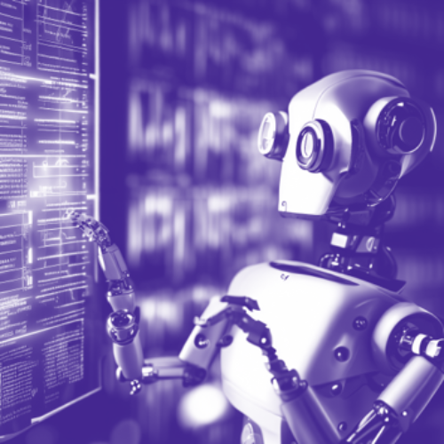
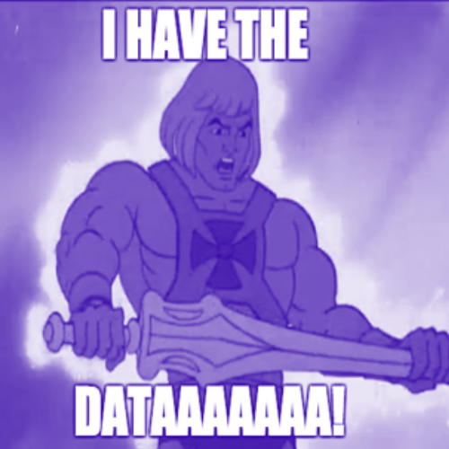
Objective
Building a machine learning model that predicts whether an online customer of a retail shop will make their next purchase in the upcoming quarter!
The Online Retail II dataset contains rich information about each transaction, such as InvoiceNo, StockCode, Description, Quantity, InvoiceDate, UnitPrice, CustomerID, and Country.
We can use this information to segment your customers, predict their future purchases, identify cross-selling and upselling opportunities, and personalize your offers and promotions.
But how do we make sense of this dataset? How do we extract meaningful insights that can guide the actions? That’s where this analysis comes in. This analysis will take you through the steps of data preprocessing, exploratory data analysis, feature engineering, clustering, and classification models. Along the way, you will discover interesting findings about customer behavior and preferences, and learn how to use machine learning techniques to predict customer outcomes.

Slide 5
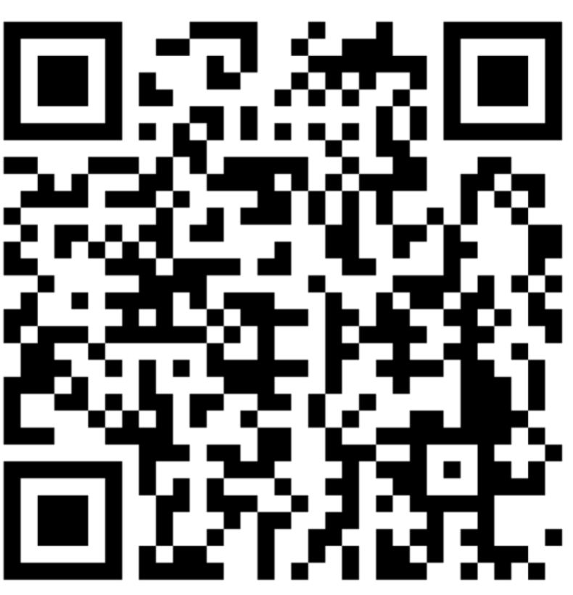
Demo
You can try too!!! Just scan the QR Code

Slide 6
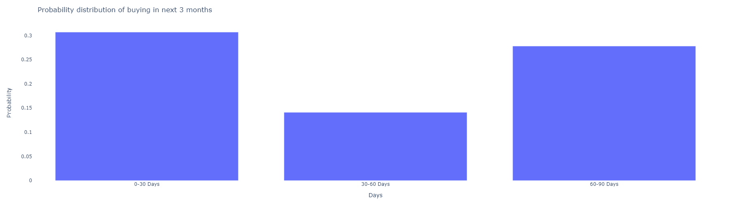
Deliverables
We have deployed an App where the customer will give Customer ID as input, where we will show a historical revenue chart of the customer which will show us the probability whether the customer will buy the product in the next 30 days or not.
If the customer buys in the next 90 days we will show a probability distribution window which will show if the customer is buying before 30 days, between 30 to 60 days and 60 to 90 days.
Using cosine matrix we show the similar customers who have bought the same product and also show the recommended products for the customer based on Collaborative filtering
Example1: Customer ID - 15996
We can see that this Customer has a probability to buy products in the next quarter, the probability of this customer buying in the next 30 days is around 30%, also we have given a list of products this customer has bought previously.
We have shown all the similar customers who have a similar trend of buying the products for next quarter along with some recommendations of products that this customer can buy.

Slide 7
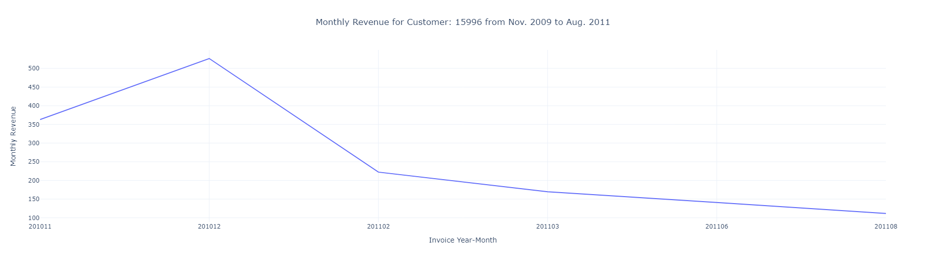
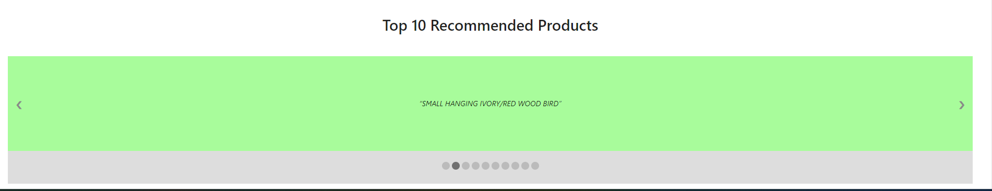
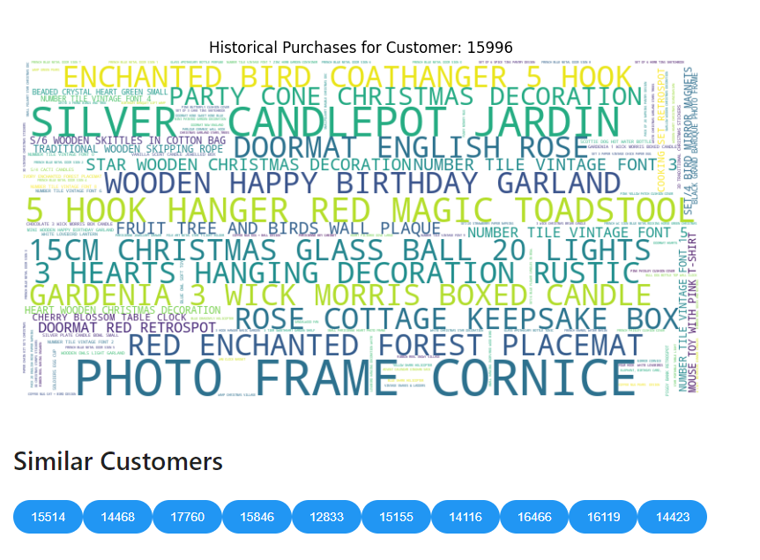

Slide 8
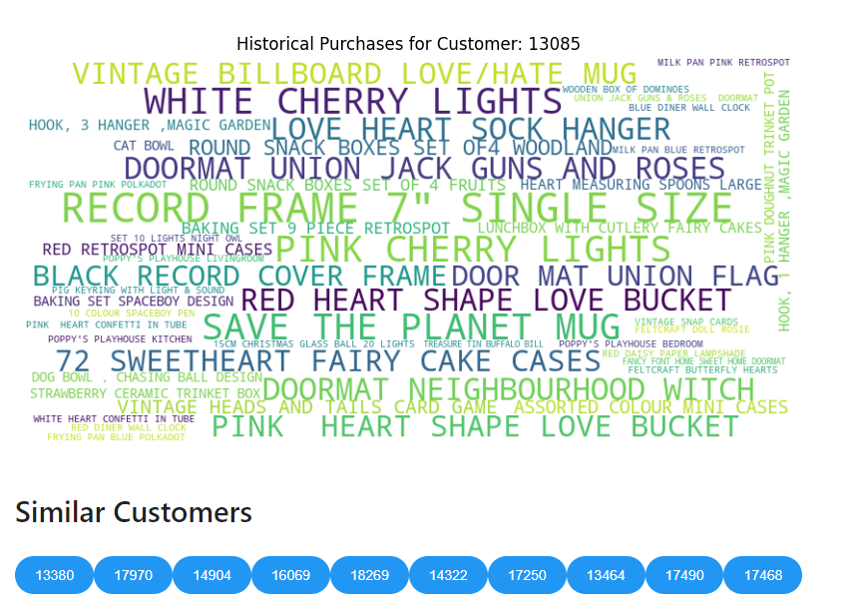
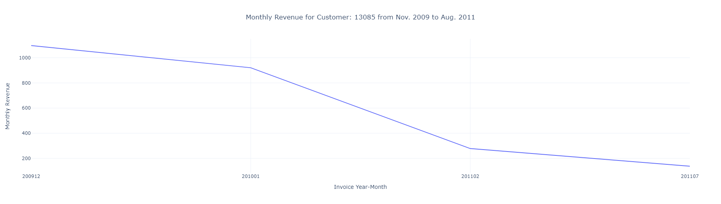
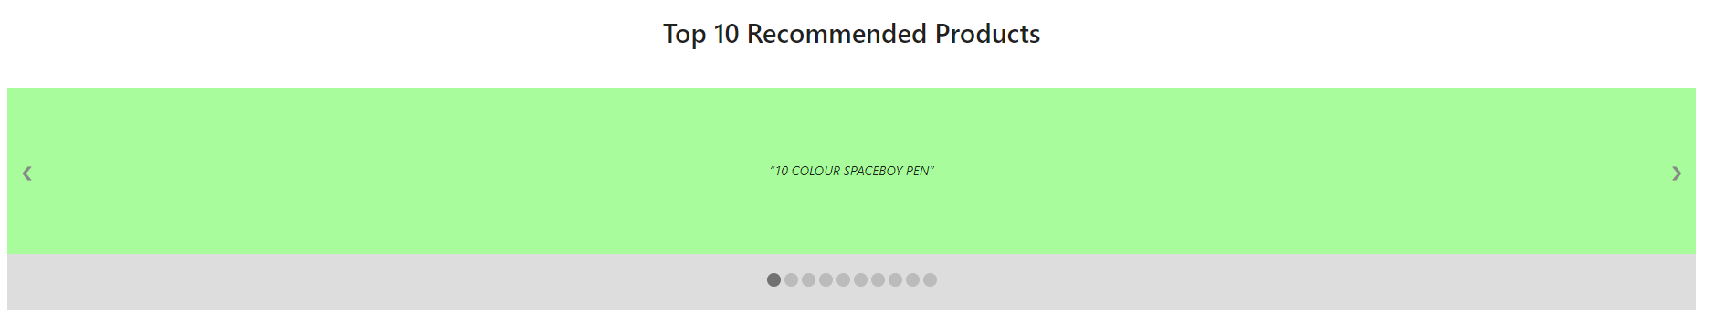
Example2: Customer ID - 13085
We can see that this Customer will not buy products in the next quarter, also we have given a list of products this customer has bought previously.
We have shown all the similar customers who have a similar trend of not buying the products for next quarter along with some recommendations of products.

Slide 9
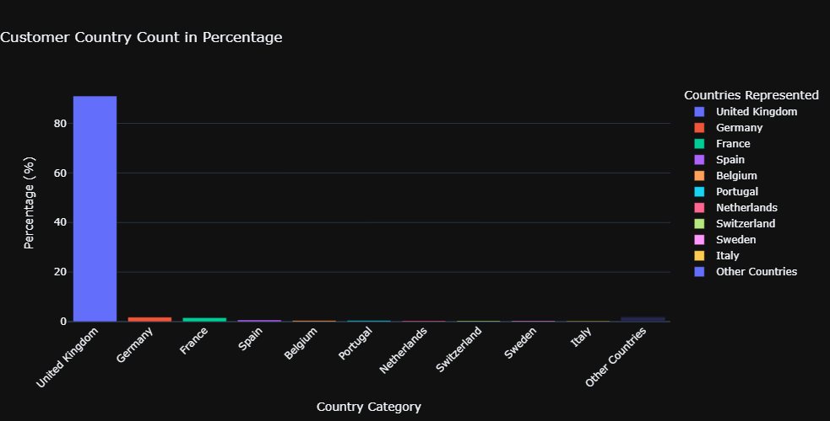
EDA
The dataset comprised information on 5942 online customers originating from 43 distinct countries. Within the group of online customers associated with the retail store, the majority, accounting for 90.8%, were residents of the United Kingdom.
Given the substantial customer presence in the United Kingdom, it's quite expected that as much as 83% of the company's revenue originated from this region.

Slide 10
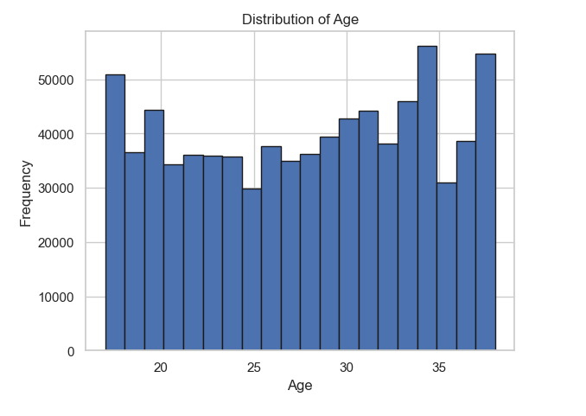
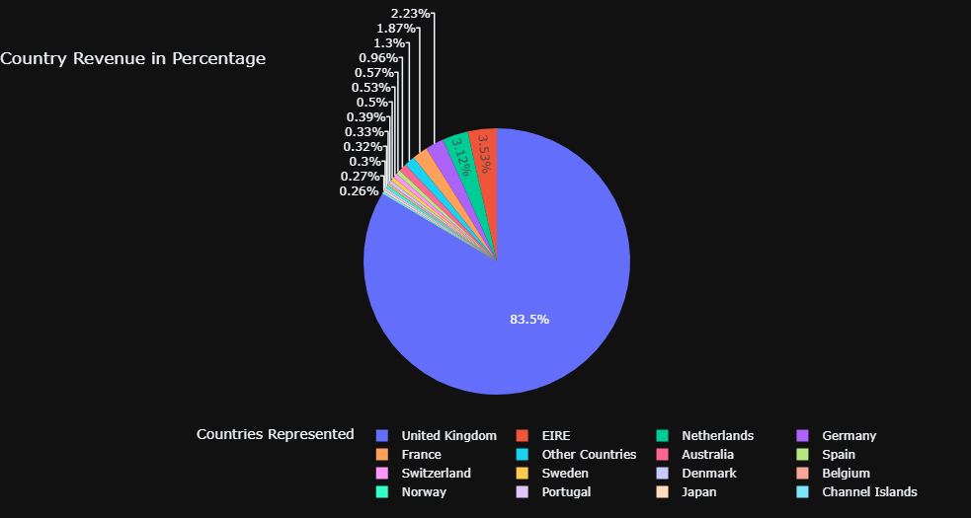
We also have shown the age distribution of Customers which mostly is between 20 to 35 years.
From the distribution we can see that 60% of customers are in the age group of above 30.

Slide 11
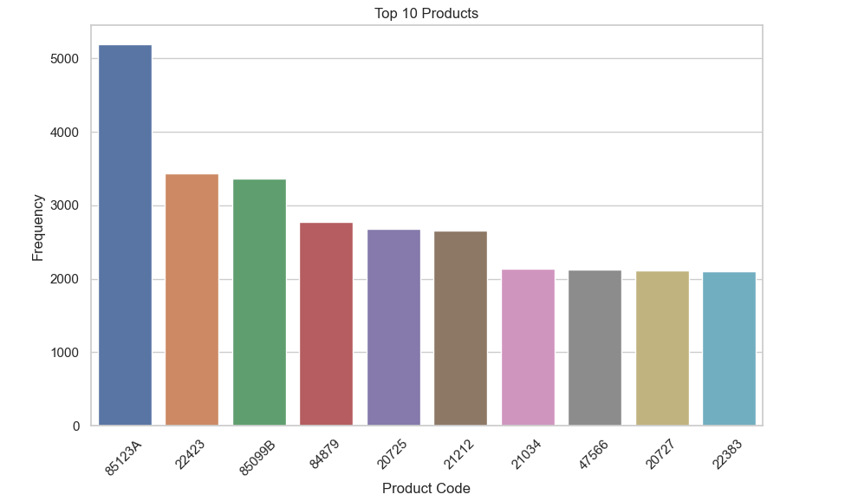
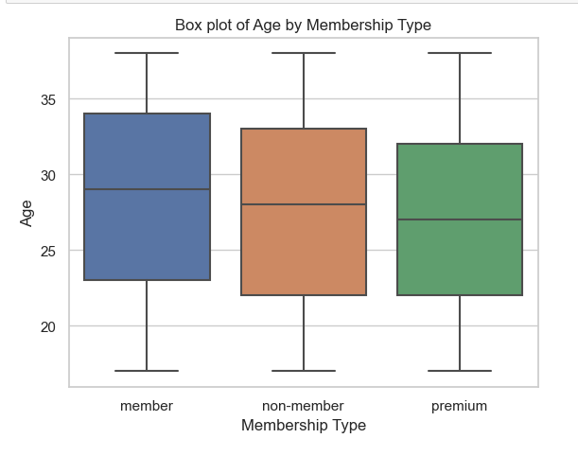
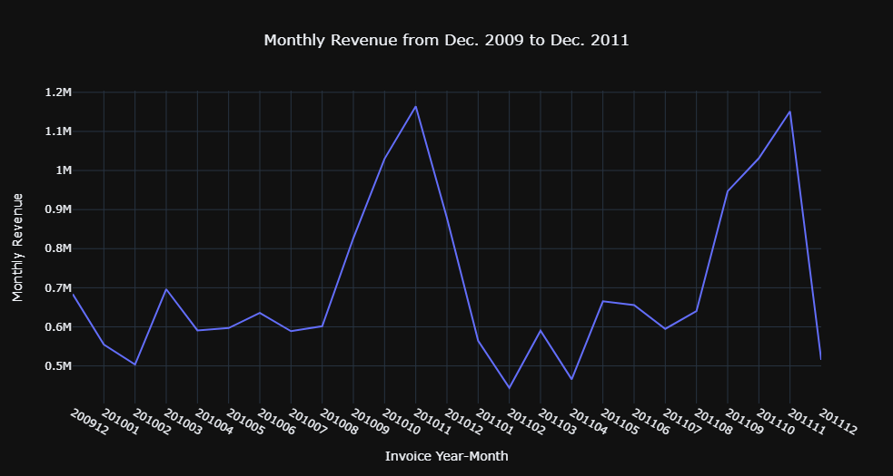
We have also shown the top 10 products that are bought by the customers.
It's evident that the company achieved its peak revenue in November 2010, closely followed by November 2011. Moreover, there's an upward trend in monthly revenue following the month of August.
Based on the analysis, we can offer a suggestion to the management regarding expanding the customer base beyond the UK. Leveraging the established UK customer base, a potential strategy is to introduce a "win-win promotion." In this approach, existing customers could refer new customers from other countries through a web link. If the referred customer makes a purchase using the link, both the referrer and the new customer receive a cash voucher for their next purchase. This approach ensures satisfaction for the company, existing customers, and new customers, thereby fostering growth and engagement.
Notes:
Monthly revenue - high during Nov- dec (season)

Slide 12
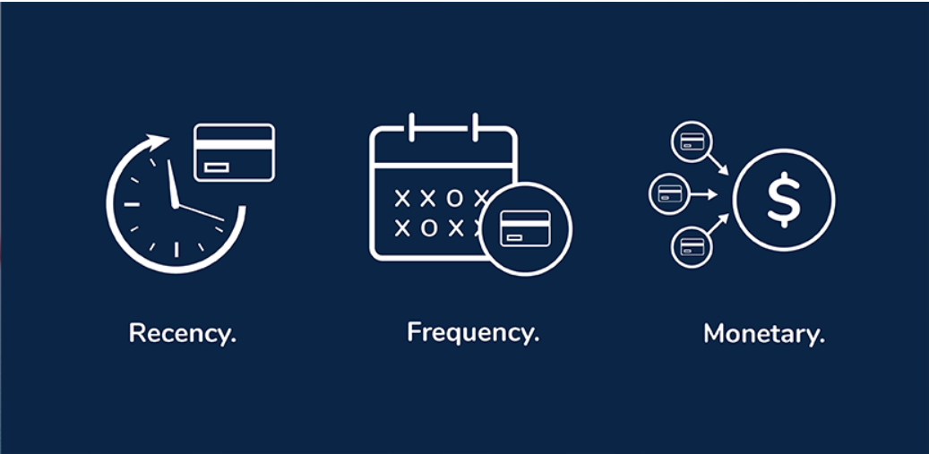
Data Preparation RFM
The RFM formula encompasses the computation of three essential metrics:
Recency (R):
The Recency factor is determined by subtracting the date of the customer's latest transaction from the current date. A lower R value suggests recent engagement, whereas a higher value indicates prolonged inactivity.
R = Current Date - Last Transaction Date
Frequency (F):
Frequency measures the count of transactions made by a customer within a specific time frame. A higher F value implies regular interactions, while a lower value suggests infrequent engagement.
F = Number of Transactions
Monetary Value (M):
Monetary Value signifies the total amount spent by a customer on transactions. Higher M values correspond to more significant spending tendencies, whereas lower values indicate more conservative purchasing behavior.
M = Sum of Monetary Amounts
RFM segmentation uses K-means clustering to group customers by purchase behavior. RFM values are standardized for consistent scales.
K-means then assigns customers to clusters based on normalized RFM values. Results are stored in a 'Cluster' column, helping businesses tailor marketing strategies to customer preferences and behaviors.
In summary, RFM captures fundamental dimensions of customer behavior through mathematical expressions. It quantifies recency, frequency, and monetary impact, offering a multi-dimensional viewpoint that businesses can exploit for segmentation, targeted marketing, and predictive modeling.

Slide 13
Methodologies and Assumptions
In this step, several machine learning models were selected to be trained and evaluated. These models included techniques such as Logistic Regression, Gaussian Naive Bayes, Random Forest, etc. The aim was to have a diverse set of algorithms to compare and choose the best-performing one.
Various classification models are extensively evaluated using cross-validation techniques. These models include Logistic Regression, Gaussian Naive Bayes, Random Forest, Support Vector Classifier (SVC), Decision Tree, Gradient Boosting, XGBoost, and K-Nearest Neighbors.
We specifically focused on XGBoost and Logistic Regression for analysis. For each model, relevant metrics like accuracy, F1 score, recall, precision, and execution time are recorded in a dictionary. K-fold cross-validation (with five folds) assesses model performance on training data, utilizing the Cross_val_score function from sklearn to calculate average scores across different folds for each metric.
The results are aggregated into a DataFrame and sorted by accuracy, F1 score, and execution time. This summarized comparison offers insights into model performance, aiding in the identification of the best model based on evaluation metrics.

Slide 14

Challenges
Data Availability: Gathering accurate and comprehensive data on customer demographic has been challenging.
Various Models: We have tried with various models to get the better predictions, but we felt like if we have some more time we could have experimented with different modelling variations.
Cloud Deployment: Given resource constraints and time limitations, achieving this was not feasible. We will keep it for future scope.
Implementation Hurdles: For the demo purpose, we had to rely on POC app deployment to mimic the actual deployment architecture instead.
Train the model after performing the through EDA and data preprocessing.
After evaluating the various models we picked the best models based on goodness of fit measures.
We converted them into pickle files so we don’t have to retrain and perform modelling everytime.
We developed another program to read the pickle files and historic data of customers from a parquet file (Csv converted to optimize the size).
Transformed the jupyter notebook into an APP using mercury.
We can also reload the pickle files when we fine tune to model, but hosting on the web took a toll because of package and versioning issues.

Slide 15

Future Work
Areas for future work:
Integration of Real-Time Model run and execution.
Integrating our current solution to Azure Services.
Model based approach for Product Recommendations.
Exploring features to enhance model performance.

Slide 16
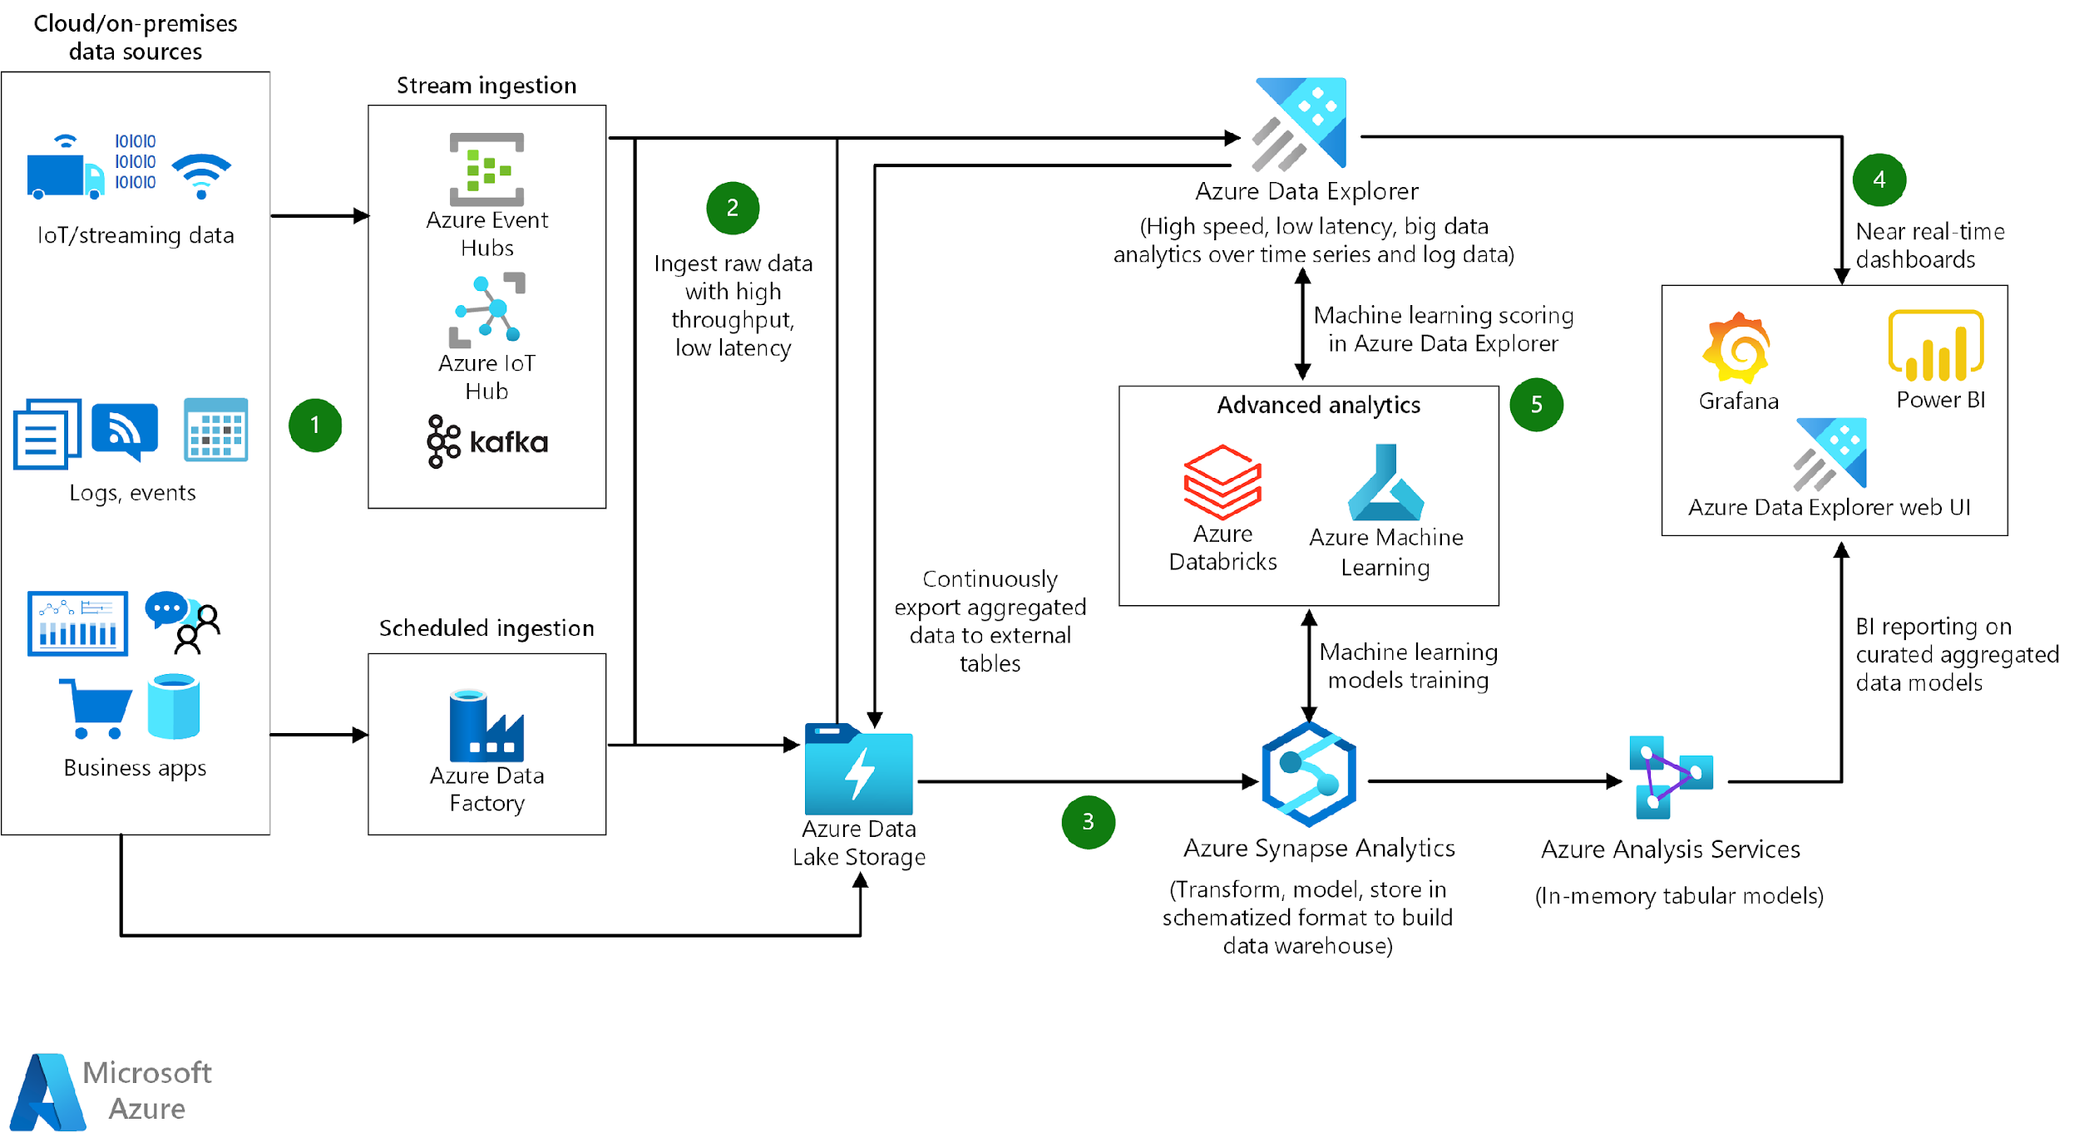
Future Work For Real Time Deployment On Azure
Notes:
Let me take you through our proposed enterprise technology architecture.
As there can be various sources of data, we have Azure Data Factory which orchestrate data refresh for structured data.
Components like Azure Event Hub and IOT Hub can be used to fetch streaming data. All sources’ data is being stored in Azure Data Storage which feeds data into Machine Learing components components of Azure namely Azure Synapse Analytics and Azure Machine Learning. After the model run, we can feed the output to some Vizualization tools like Power BI to display necessary results.

Slide 17


